Slide 1

HISTORY OF THE EMERGENCE OF INDEPENDENT BANGLADESH
Dr. Md. Abdul Alim
B. A.(Hon’s), M. A. (History), M. Phil. (Raj), Ph. D. (Raj)
Email:doctorabdulalim64@gmail.com
Cell: +880 01885-741745

Slide 2
DISCUSSION CONTENTS
1. Concept of History & Heritage
2. Difference between History & Heritage
3. Definition of History & Heritage by different Historians
4. Sources of History
5. Explanation of the origin of the name Banga or Bangla
6. Introduction – Bangladesh
Administrative data, Economy, Climate of Bangladesh
7. Introduction - Territory & History
8. Introduction – Township /Janapads
Gauro, Pundra, Banga (Bangla), Harikel, Somototh, Barendra, Tamralipta,
Rarh,Chandradip, Kamrupa, Arakan

Slide 3
CONCEPTS OF HISTORY & HERITAGE
What is History?
History is basically the study of the past. It tells us about the events and incidents that took place in the past. The term history can denote the history of the human race, the origin of civilization or even the events related to the conception of a place or an institution. Every place or rather everything on earth has a history. It is history that helps us to determine how a particular thing came into being, how it evolved over the years, and what made it the object or concept it is today.
What is Heritage?
Heritage is always linked to history. Heritage refers to a thing that is transmitted by or acquired from a predecessor. We generally use this term to refer to treasured objects and qualities such as historic buildings and traditions that have been passed down from previous generations. So there can be no heritage without a history.

Slide 4
DIFFERENCE BETWEEN HISTORY & HERITAGE
Main Difference Between History Vs Heritage
History and heritage are two words that always go together. History is the study of the past and heritage refers to valued objects and qualities such as historic buildings and traditions that have been passed down from previous generations. This the main difference between history and heritage.
Definition: History is the study of past events, particularly in human affairs. Heritage refers to treasured objects and qualities that have been passed down from previous generations.
Past: History is the past as a whole. Heritage is a reminder of the past.
Areas: History looks at the origins of civilizations, their evolution, etc. Heritage is connected with artifacts, sites, buildings, traditions, literature, etc.

Slide 5
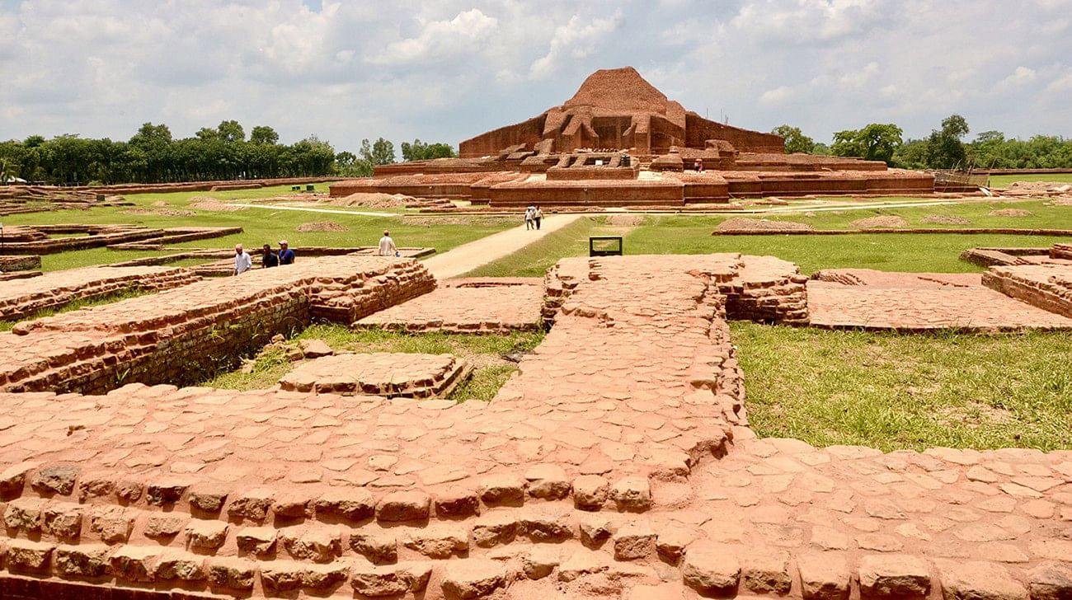
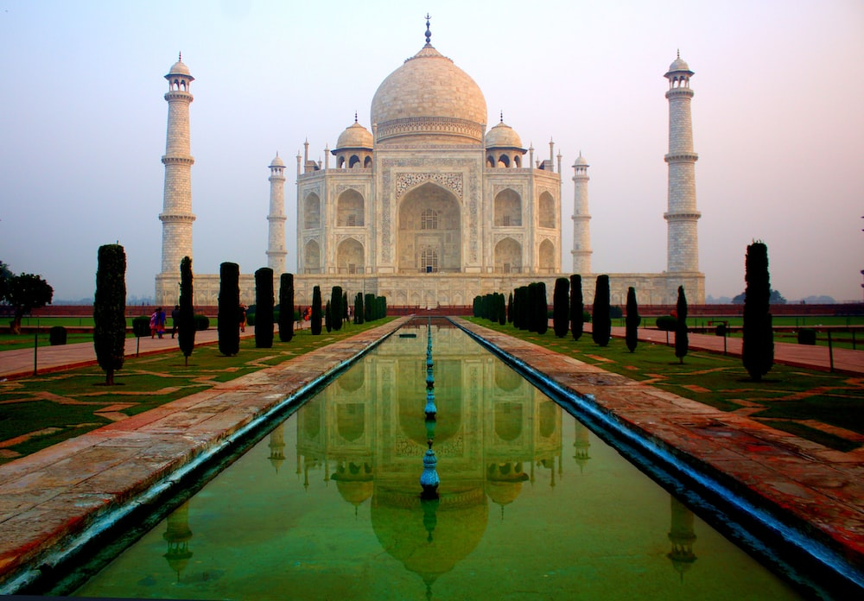
IMAGES FOR HISTORICAL HERITAGE
Somapura Mahavihara, Bangladesh
Taj Mahal, India

Slide 6
DEFINITION OF HISTORY & HERITAGE BY DIFFERENT HISTORIANS
The word History (in Bengali Itihas) comes from the Bengali word 'Itiho' which means heritage. Heritage refers to past habits, education, language, art, literature and culture which are preserved for the future.
The English word History has come from the Greek word Historia whose Bengali synonym is Itihaas. The word Historia was first used by Greek historian Herodotus (fifth century B.C.). He is famous as the father of History. He believed that history is to investigate or write what in true sense existed or took place.
He investigated into different issues of the war that had taken place between Greece and Persia through his research. In this research he gave description of the obtained information, important events and the stories of victory of the Greek so that next generations do not forget these events and these events inspire them with patriotism.
Herodotus who first combined the two concepts. History and Investigation. As a result, History turned into science, became completely information-based and became a subject of research. Actually, never-ending flow of events in human society is called History.

Slide 7
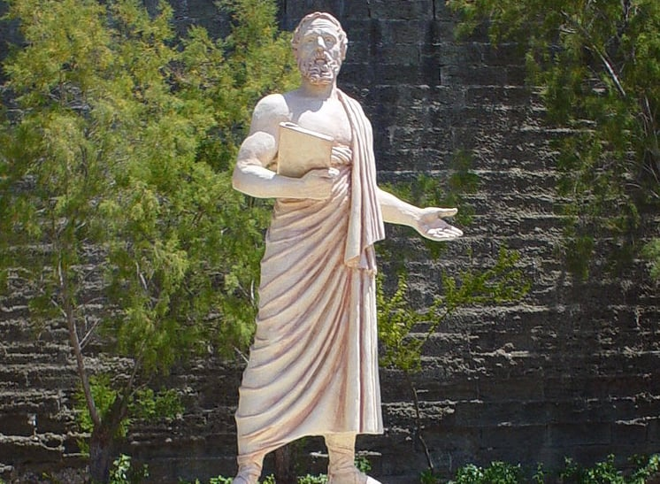
THE FATHER OF HISTORY
Herodotus of Halicarnassus, the Father of History.
Herodotus (or Ἡρόδοτος), born in Halicarnassus in 484 BC, was one of the most brilliant Greek thinkers of all time and is known worldwide as “The Father of History.”

Slide 8
SOURCES OF HISTORY
The sources of history refer to the information and evidence based on which it is possible to establish the historical truth. The importance of historical sources knows no bounds in writing the actual history. The sources of history can be divided into two groups, such as
1. Written sources; and
2. Unwritten sources.
Written Sources
The written sources of writing history include literature, overseas account, documents etc. There is some information available in different works. For example: The Vedas, Kautilya's Arthasastro, Kalahan's Rajatarangini, Minhaj-us-Siraj's Tabkat-E-Nasiri, Abul Fazal's Ain-E- Akbari etc.
Descriptions of the overseas travelers are always considered the most important sources. For example: The descriptions of the Chinese travelers Fa-hien and Hiuen-Tsang respectively who came to Bengal fifth to seventh century. In the subsequent times, there was description about this area/ zone in the writings of others including Ibn Batuta.

Slide 9
SOURCES OF HISTORY
Unwritten Or Archeological Sources
Unwritten or archeological evidences refer to those things or sources from which we can get a variety of historical information about a particular time, place or person. Archeological evidence are included in unwritten elements. For example: coins, stone inscriptions, column inscriptions, copper inscriptions, etc.
New archeological discoveries can change the history of a nation. For instance: the recent archeological discovery of Wari-Bateshwar in Narsingdi. It has been proved in the archeological evidence of that place that even before two thousand five hundred years back there was the existence of urban civilization in Bangladesh. As a result of this discovery, a new horizon of the civilization of ancient Bengal is going to be exposed and people's conceptions about the ancient civilization of Bengal are getting changed day by day. The time is not too far when the ancient history of Bengal will have to be written afresh.

Slide 10

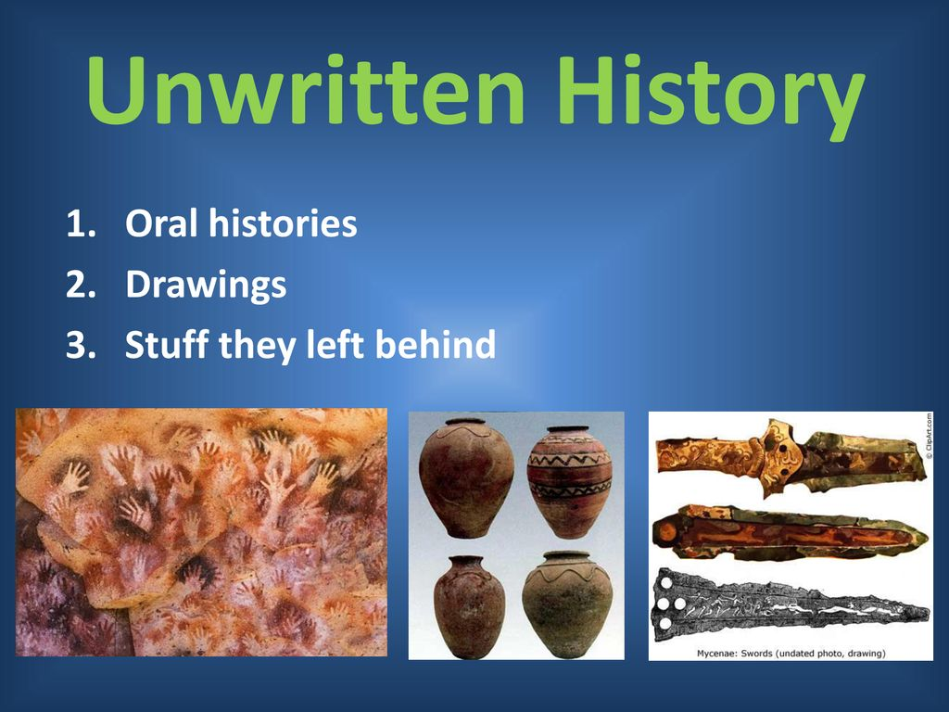
IMAGES FOR WRITTEN & UNWRITTEN SOURCES

Slide 11
THE ORIGIN OF THE NAME BANGA OR BANGLA
Introduction: There are many differences of opinion about the origin of the name Banga or Bangla. According to some, the name Bengal and later Bangala originated from the name Banga. Some believe that a group of people called Bong in the past lived in the region and after them the region came to be known as Banga. Many people think that the submerged damp region is called Banga or Bengal. The origin of the name Banga or Bangla is discussed below:
1. Bengali in Travelers' Writings: Bangla was known as 'Bengal' during the British rule. In the 16th and 17th centuries European writings mention the country called 'Bengal'. Marca Polo is referring to the city of Bengal. Gastoldi in his map shows Bengal to be west of Chattigram.
2. According to Ahmad Rafiq: Ahmad Rafiq said in the book 'Bengali's Independence War', '......... However, the independent Bengali-land called Gangaashtra or Gangahridi is recognized as the most ancient state.
3. According to Ajay Roy: Ajay Roy says in the article 'Bengali Janm', the first mention of 'Beng' people and townships can be seen in Aitareya Aranya.

Slide 12
THE ORIGIN OF THE NAME BANGA OR BANGLA
4. According to Abul Fazl: The poet Abul Fazl in Ain-e-Akbari says about the origin of the name 'Bangla' in Emperor Akbar's meeting: "The ancient name of this country was Banga. In ancient times its kings used to build 'Al', a tower 10 yards high and 20 yards wide; Bengal and the origin of the name Bangla." So Bengal+Al = Bengal > Bengal > Bangla.
5. According to Sukumar Sen: Sukumar Sen has expressed the view that those who live in the watery country in the east are 'Banga' and their home-land is 'Banga-desh'.
6. According to Rameshchandra Majumdar: Rameshchandra Majumdar thinks that 'Beng' and 'Bengal' were two separate countries from ancient times. From the name of the country 'Bengal' the whole country has been named 'Bangla' over time. The name 'Bengal' which is called 'Bengal' by the present day people of Bangladesh, carries the memory of that ancient 'Bengal' country.
7. According to Niharranjan Roy: Niharranjan Roy, along with Abul Fazal, said that the construction of small and large dams (al) to prevent floods and tidal currents in riverine countries was inevitable for agriculture and habitats. And 'Banga' was joined with 'Al' and it was named 'Bangala'.

Slide 13
THE ORIGIN OF THE NAME BANGA OR BANGLA
Conclusion:
Finally, it can be said that from the ancient township 'Bengal' to 'Bangalah' or 'Bangala' in the Middle Ages, 'Bengal' of the Portuguese during the British rule, 'Bengal' of the English, 'East Bengal' during the Pakistan rule (1947-1955), East After gaining independence from Pakistan (1955), and the Great War of Liberation, the name 'Bangladesh' became well established. So, this is how Bengal > Bengal > Bangala > Suba-i-Bangala > East Bengal > East Pakistan > Bengal originated.
The origin of the name and the ethnographic identity of Bengalis.
Through a long struggle, independent Bangladesh was established in 1971. The word Bangla has undergone various changes. But it is briefly discussed the origin of this Bengali name. We all know that this region was divided into different towns from ancient times. Among them, Gaur and Banga. From this Banga, the word Bengali was gradually changed to Bengali. But there are many doctrines, disagreements and there are many in this matter.

Slide 14
THE ORIGIN OF THE NAME BANGA OR BANGLA
Different Doctrines:
Abul Fazal in his famous book 'Ain-i-Akbari' said about the origin of the name 'Bangala' ---Bengal. The name Bangal or Bangala originated by adding 'Al' to this Bengal.
Many people have thought that 'Banga' is a Chinese and Tibetan word. They may think that because the name of Bengal is similar to the name of rivers like Ganges, Huangho, Yangsiqiang etc.
Ramesh Chandra Majumdar thinks that 'Bengal' is the name of the country. During the reign of Ilyas Shah, his title was 'Shah-i-Bangala'. Also, in the 16th century, the Portuguese referred to Bengal as 'Bangala'.
Although historians differ about the origin of the name Bengali, it is emphatically ancient

Slide 15
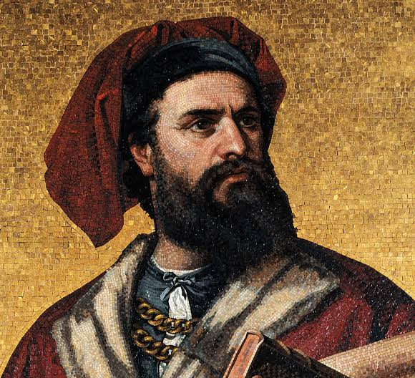
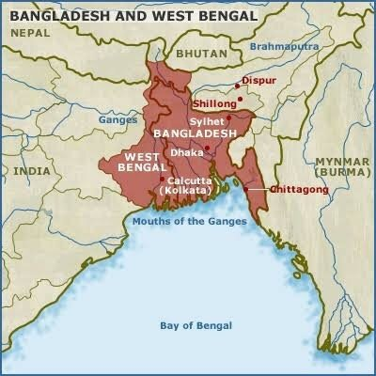
IMAGE FOR MARCO POLO OF ANCIENT BENGALI OR BANGLA
Marco Polo, (born c. 1254, Venice [Italy]—died January 8, 1324, Venice),

Slide 16
INTRODUCTION – BANGLADESH
Bangladesh is located to the east of India on the Bay of Bengal. It is a South Asian country marked by lush greenery and many waterways. Its Padma (Ganges), Meghna and Jamuna rivers create fertile plains, and travel by boat is common. On the southern coast, the Sundarbans, an enormous mangrove forest shared with Eastern India, is home to the Royal Bengal Tiger.
The official name is the People's Republic of Bangladesh. Bangladesh is the eighth most populous country in the world, with a population exceeding 165.15 million people in an area of either 148,460 square kilometres/57,320 sq mi (previously 147,570 sq. kilometres/ 56,980 sq mi).
Bangladesh is one of the most densely populated countries in the world. Bangladesh shares land borders with India to the west, north, and east, and Myanmar to the southeast. In the south, it has a coastline along the Bay of Bengal. It is narrowly separated from Bhutan and Nepal by the Siliguri corridor; and from China by 100 km of the Indian state of Sikkim in the north.

Slide 17
INTRODUCTION
Administrative data
Official Name : People's Republic of Bangladesh
Capital and largest city : Dhaka
Official national language : Bengali
Ethnic Groups : 98% Bengalis and 2% minorities
Religion : 91.04% Islam, 7.95% Hinduism, 0.61% Buddhism,
0.4% , Christianity and 0.1% others (2022).
Population : 165.15 million (2022) – 16.51 crore
Male-Female : 81,712,824 are males and 83,347,206 females -- which means for every 100 females, there are 98.04 males or the country has 1,634,382 more females
than males

Slide 18
INTRODUCTION
Administrative data
Population Growth Rate : 1.22 (2022)
Assembly : National Parliament (Jatiya Sangsad)
Largest seaport : Chittagong (2nd largest city also)
Independence day : 26 March, 1971
Victory Day : 16 December, 1971
Government : Unitary dominant party parliamentary republic
Literacy rate : 74.66% in 2022

Slide 19
INTRODUCTION
Administrative data
Divisions : 8 (Comilla and Faridpur are proposed)
Districts : 64
Upazila/sub-districts : 495
Unions : 4,571
City Corporations : 12
Municipalities (Pourashova) : 330
Area : 148,460 sq KM/ 57,320 sq mile
Land and water proportion : Land – 130,170 sq km and water 18,290 sq km
Density : 1,119/km (Dhaka led the ranking of cities with
the highest population density in 2021,
with 36,941 residents per square kilometer)

Slide 20
Introduction
Administrative data
Standard Time : GMT+6
Life Expectancy : 72.8 (Male 71.2 and Female 74.5)
Mean Age at Marriage : Male 25.2 and female 19.1
Northern Bengal : Comprising with Rajshahi and Rangpur divisions
Eastern Bengal : Comprising with Chittagong, Sylhet, proposed
Comilla divisions (also known as Surma-Meghna
river system)
Central Bengal : Comprising with Mymensingh and Dhaka divisions
(excluding proposed Faridpur division)
Southern Bengal : Comprising with Barisal, Khulna and proposed
Faridpur divisions

Slide 21
INTRODUCTION
Economy
GDP Growth at Constant Price : 7.25
Per Capita National Income : 2,41,470
Per Capita National Income (In US$ ) : 2,824
Incidence of Poverty : 20.5% (2018-19)
Incidence of Extreme Poverty : 10.5% (2018-19)
Proposed budget for FY 2022-23 : 678,064 (crore)

Slide 22
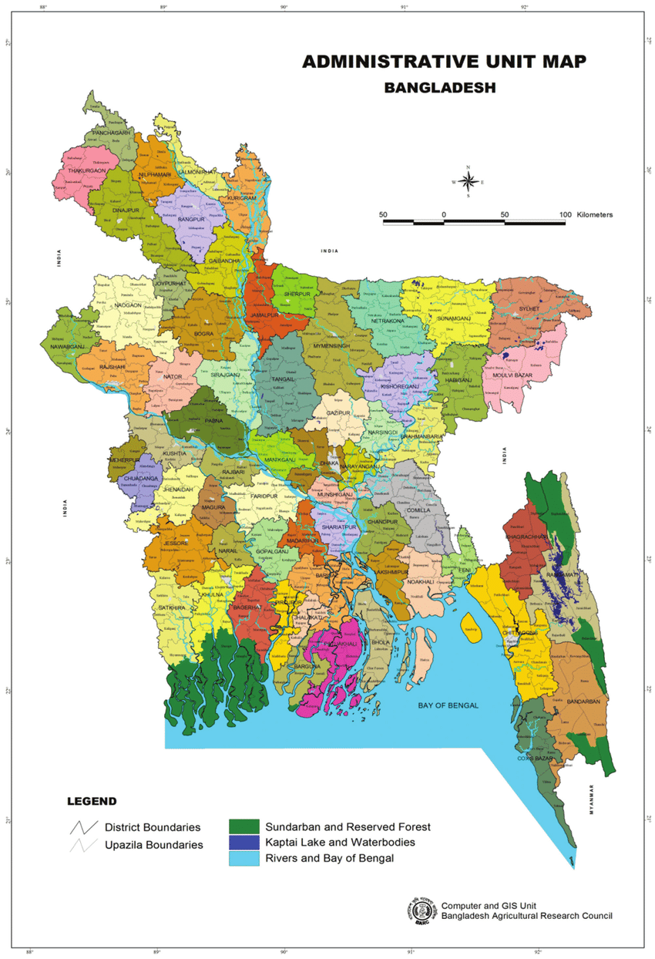
ADMINISTRATIVE UNIT MAP BANGLADESH

Slide 23
INTRODUCTION
Climate of Bangladesh
Bangladesh has a tropical monsoon-type climate, with a hot and rainy summer and a dry winter. January is the coolest month with temperatures averaging near 26 degree C (78 d F) and April the warmest with temperatures from 33 to 36 degree C (91 to 96 d F). The climate is one of the wettest in the world. Most places receive more than 1,525 mm of rain a year, and areas near the hills receive 5,080 mm. Most rains occur during the monsoon (June-September) and little in winter (November-February).
Bangladesh is subject to devastating cyclones, originating over the Bay of Bengal, in the periods of April to May and September to November. Often accompanied by surging waves, these storms can cause great damage and loss of life. The cyclone of November 1970, in which about 500,000 lives were lost in Bangladesh, was one of the worst natural disasters of the country in the 20th century.

Slide 24
INTRODUCTION - TERRITORY AND HISTORY
Territory and history
Although Bangladesh has existed as an independent country only since the late 20th century (since 1971), its national character within a broader South Asian context dates to the ancient past. The country’s history, then, is intertwined with that of India, Pakistan and other countries of the area.
The land of Bangladesh, mainly a delta formed by the Padma (Ganga) and the Jamuna (Bramaputra) rivers in the northeastern portion of the Indian subcontinent, is protected by forests to the west and a myriad of watercourses in the centre. In early times a number of independent principalities flourished in the region—called Bengal —including Gangaridai, Banga, Pundra, and Samatata, among others. In the 14th century Shamsuddin Ilyasn Shah was instrumental in unifying many of these principalities.

Slide 25
INTRODUCTION - TERRITORY AND HISTORY
The Mughals added more territories, including Bihar and Orissa (now states of India), to constitute Suba Bangalah, which the British colonial administration later called the Bengal Presidency. In 1947, when British colonial rule ended, a downsized province of Bengal was partitioned into East Bengal and west Bengal. East Bengal was renamed East Pakistan in 1956, and in 1971 it became Bangladesh.

Slide 26
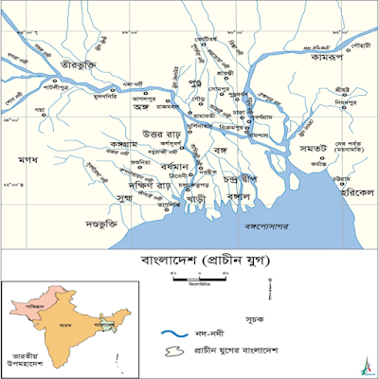
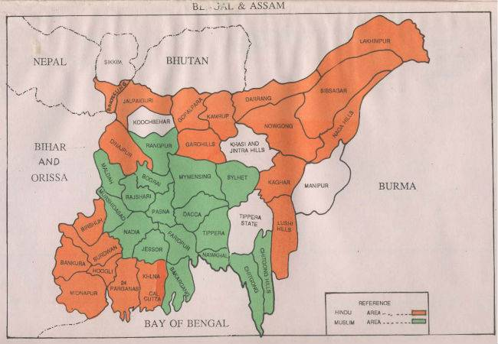
INTRODUCTION - TERRITORY & HISTORY
Ancient Map of Bangla

Slide 27
INTRODUCTION - JANAPADS
SL No | Ancient Janapads | Current Location
1 | Pundra | Parts of greater Bogra, Rajshahi, Rangpur and Dinajpur districts are special.
2 | Barindra | Bogra, Pabna, Rajshahi division and some parts of Rangpur and Dinajpur.
3 | Bango | Kushtia, Jessore, Nadia
4 | Gauro | Malda, Murshidabad, Birbhum, and Chapainawabganj
5 | Somototh | Greater Cumilla and Noakhali regions
6 | Harikel | Chittagong, Chittagong Hill Tracts, Tripura, Sylhet
7 | Chandra Dip | Barishal, Bikrampur, Munshiganj district and its adjoining areas.
8 | Kamrupa | Jalpaiguri, Greater Goalpara District of Assam, Greater Kamrup District
9 | Tamrolipto | Medinipur District
10 | Arakan | Cox’s Bazar, Parts of Myanmar, South of the Karnafuli River

Slide 28
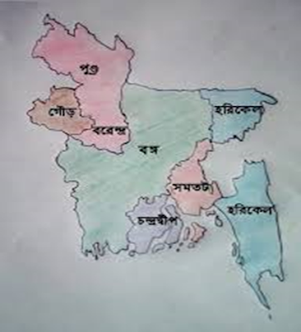
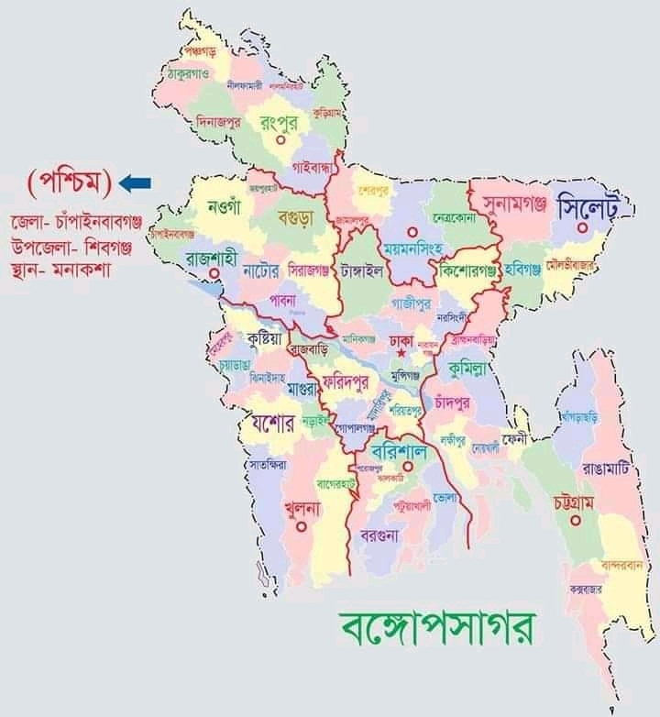
INTRODUCTION - JANAPADS

Slide 29
INTRODUCTION - TERRITORY AND HISTORY
Gauro: Though Gauro name is quite familiar but there are much controversy about which area was the actual Gauro and how they named it. The first mention of Gauro was found in panini’s book mentioning the industries and agricultural products of this town. In the 7th century, Karnasuvarna of Murshidabad district was the capital of Shashanka, the king of Gauro. Gauro was most famous under Pala dynasty. In modern times Maldaha, Murshidabad, Birbhum and some parts of Burdwan are considered to be the borders of Gaur.
Pundra: Among ancient Janapads Pundra is very important. It has been said that a tribe named “Pundra” build up this Janpads. This nation is mentioned in Vedic literature and Mahabharata. The name of the capital of Pundra was Pundranagar. Later that its name changed to Mohasthangar. Possibly at the time of Mourja king Ashok (273 AD.-232 AD.) this ancient Pundra lost its independence. With the growth of prosperity it turns into Pundrabardhan at 5Th-6Th century AD. Experts claims that Mohasthangar (7 miles from Bogra) is the ruins of ancient Pundrabardhan. From the historical prospect Pundra was the most enriched Janapad.

Slide 30
INTRODUCTION - TERRITORY AND HISTORY
Banga (Bangla): Bangla is a very old janapad. In very ancient book it has been said that Banga was the neighbor of Magadh and Kalink. The description of this janapad also find in king Chandra Gupta, Bikramaditta and others inscription and the books of Kalidas. At the south-east side of the present Bangladesh a Janapad named Banga had build up. From different sings and other things it seems that the place between Ganga and Vhagirathi was called Banga. At the time of Pala and Sen dynasty the area of Banga had been reduced. At the end of the Pala dynasty the Banga divided into north Banga and south Banga. After that at the time of Keshob Sen and Biswa Sen Banga was divided into two parts- “Bikrampur” and “Nabbo”. Ancient Bengal was a strong kingdom, Greater Dhaka, Mymensingh, Comilla, Barisal, Pabna, Faridpur, Nayakhali, Bakerganj and Patuakhali's lower wetlands and the western highlands of Kushtia, Nadia, Shantipur and the adjoining areas of Bikrampur in Dhaka.

Slide 31
INTRODUCTION-TERRITORY AND HISTORY
Harikel: Seventh-century writers describe a town called Harikela. It is Singh, a Chinese traveler, said Harikela was the last frontier in eastern India. Harikela stretches from Sylhet to Chittagong, a parallel region of the Tripura range.
Somototh: According to the Chinese traveler Hiuen Tsang, Samatata was a new kingdom in the southeastern part of Bengal. Some experts believe that Somotata was the ancient name of Comilla. The present Comilla and Nayakhali areas, including the Meghna are included in the Samatat. 12 mile west from Comilla, Bara Kamta was the capital of Samatata. One of the ancient monuments found in Comilla Mainamati is 'Shalban Bihar'.
Barendra: Barenda or Barenda land was a part of North Bengal. Barendra was the most popular area of Pundrabardhan. After that this area introduced as Barendra. This famous janapad was situated in between Ganga and Korotoya river. Bogura, Dinajpur and a large area of Rajshahi and Pabna belonged to Barendra.
Tamralipta: To the south of Harikela, to the south of Radha was the town of Tamralipta. Tamralipta was a famous port of ancient Bengal. The Tamluk area of ​​the present Midnapore district was the center of the Tamralipta town. For maritime trade it was a famous place.

Slide 32
INTRODUCTION-TERRITORY AND HISTORY
Rarh: Rarh is an ancient town in Bengal. From the west bank of the river Bhagirathi, the southern part of the river Ganges belongs to the Rarha region. The river Ajay divides the Rarha region into two parts. North Rarh the whole of Birbhum district in the western part of the present Murshidabad district.
Chandradip: Bakla Pargana mentioned in 'Ain-e-Akbari' belongs to the present Barisal district. In the Middle age, present day Barisal district was the mainland and heart of Chandradwip. This ancient town was situated between Baleshwar and Meghna. In the Pala period, it was ruled as a territory under the rule of the Trilakeya Chandra.
Kamrupa: Jalpaiguri, Greater Goalpara District of Assam, Greater Kamrup District, these areas were belong to Kamrupa.
Arakan: Cox's Bazar, parts of Myanmar, south of the Karnafuli River were belong to Arakan.

Slide 33


